Slide 1

GAME DEV WITH ALLEGRO 5
Mouse Event

Slide 2
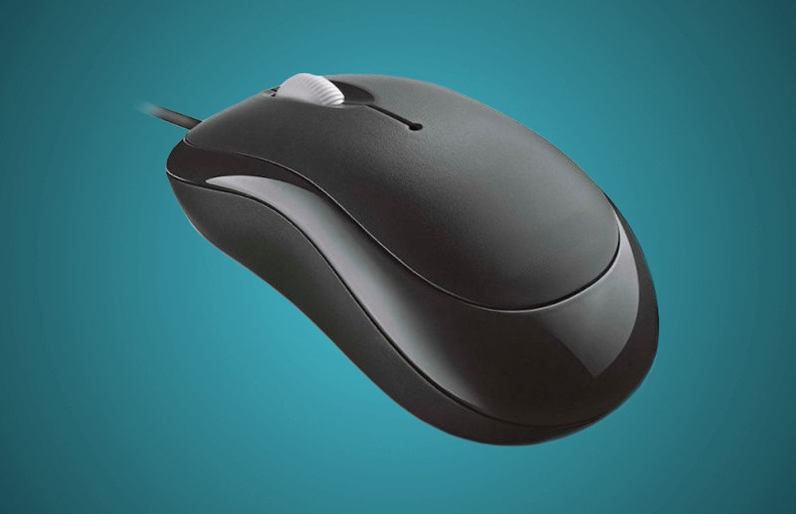
What is a Mouse Event?
An action you take or an occurrence from a mouse that is recognized by the software
Example
If you click a right mouse button, you will get a menu bar
The menu bar differs with different software

Slide 3
How to implement a Mouse Event?
Outside of the game loop
First you need to install a keyboard
al_install_mouse()
Second you need declare an Event Queue
ALLEGRO_EVENT_QUEUE *[name] = al_create_event_queue()
Third you need to register an event source
al_register_event_source([name of the ALLEGRO_EVENT_QUEUE], al_get_mouse_event_source())
Inside of the game loop
You declare an event
ALLEGRO_EVENT [name]
Put in a function that waits for an event to be pressed
al_wait_for_event([name of the ALLEGRO_EVENT_QUEUE], &[name of the ALLEGRO_EVENT])
If statement
if([name of ALLEGRO_EVENT].type == ALLEGRO_EVENT_MOUSE_BUTTON_DOWN)
if([name of ALLEGRO_EVENT].mouse.button & 1)
break the loop
After the game loop
al_destroy_display([name of the ALLEGRO_DISPLAY])
al_destroy_event_queue([name of the ALLEGRO_EVENT_QUEUE])

